Slide 1
TRIE Trees – an excellent data structure for strings
KHIZER MEHMOOD
ID: 16K-3731
DATA STRUCTURES (CS-201)
FAST-NUCES

Slide 2
Overview :
History & Definition
Motivation
Properties of Tries
Standard Tries
Complexity Analysis of Standard Tries
Comparison with other Data Structures
Applications
Conclusion

Slide 3
HISTORY :
The term Tries come from Retrieval.
Tries were first described by René de la Briandais in 1959.
The term Trie was coined by Edward in 1961 who pronounced it as ‘Trai’.

Slide 4
definition :
An excellent data structure for the representation of strings.
In computer Science, a Trie is also called Digital Trees or sometimes Radix tree or Prefix Tree.
Trie Supports very fast pattern matching.

Slide 5
Motivation :
Brute Force Algorithm takes O(n*m) time for searching the pattern of size m in the text of size n.
KMP Algorithm performs pattern matching in the time proportional to the length of text size i.e: n, and O(n) time.
If the text is larger and immutable we may want to perform the searching in O(m) time.

Slide 6
Motivation (cont.):
A TRIE is a compact data structure for representing a set of string, such that all the words in the text.
A trie supports the pattern matching queries in time proportional to the pattern size i.e : O(m).
GOAL ACHIEVED !!

Slide 7
PROPERTIES OF TRIES :
A multi–way Tree.
Each node has to form 1-n children.
Each edge of tree is labelled with a character.
Each leaf node corresponds to the string , which is the concatenation on character in path from the root to the this node.
Each node must contain a terminator , for the indication of end of the word.

Slide 8
Standard tries :
There are three types of Tries :
Standard (Prefix) Tries.
Suffix Tries.
Compressed Tries.
We will discuss about Standard Tries :
Trie is an efficient information reTrieval data structure. Using Trie, search complexities can be brought to optimal limit (key length). If we store keys in binary search tree, a well balanced BST will need time proportional to M * log N, where M is maximum string length and N is number of keys in tree. Using Trie, we can search the key in O(M) time. However the penalty is on Trie storage requirements.

Slide 9
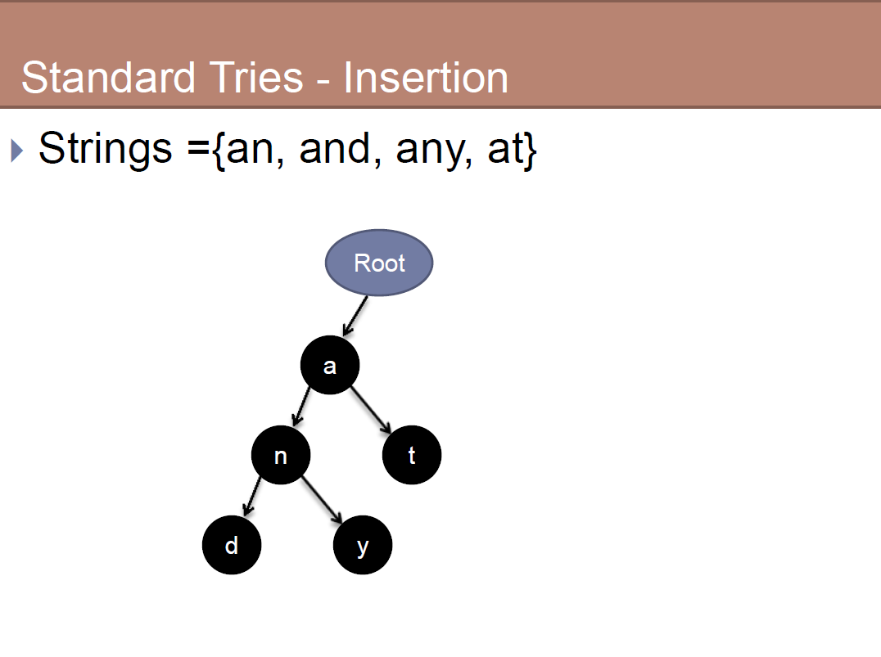

Slide 10
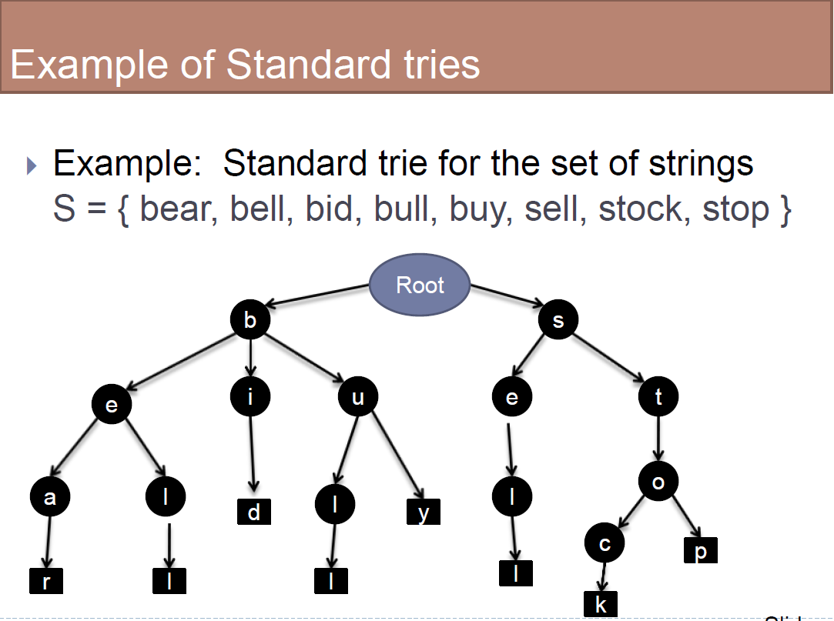

Slide 11
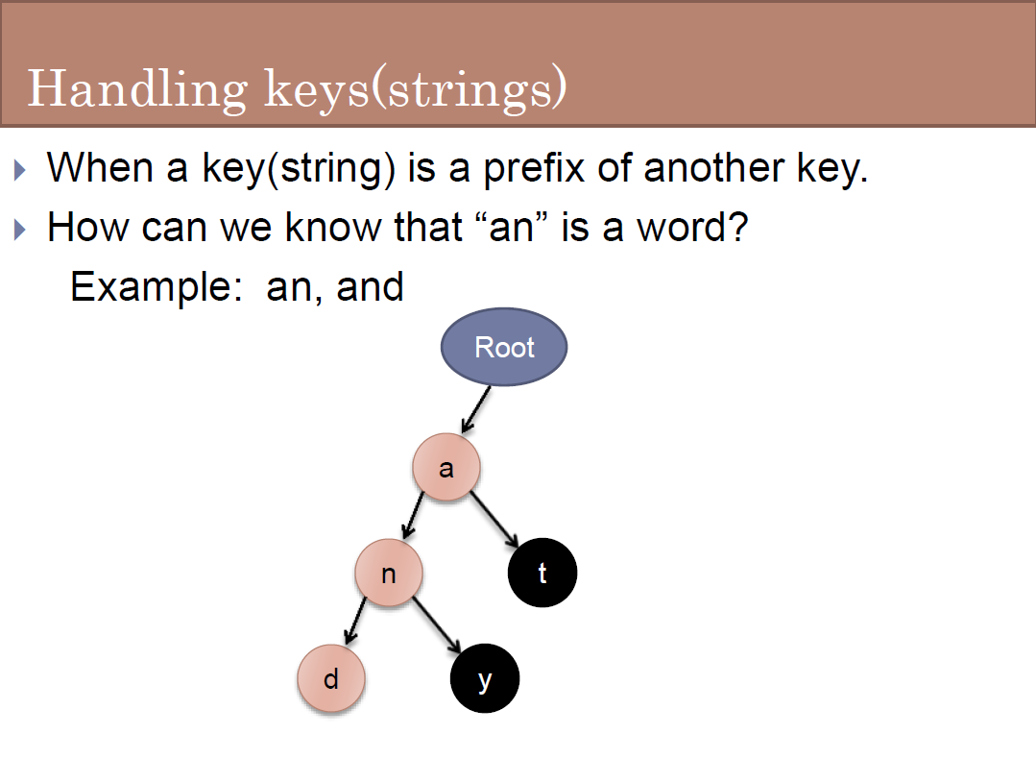

Slide 12
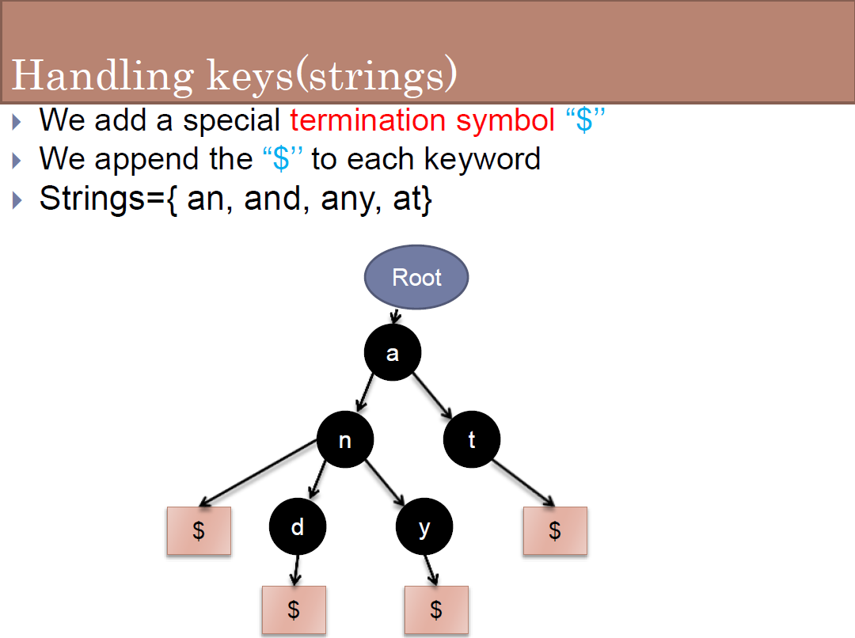

Slide 13
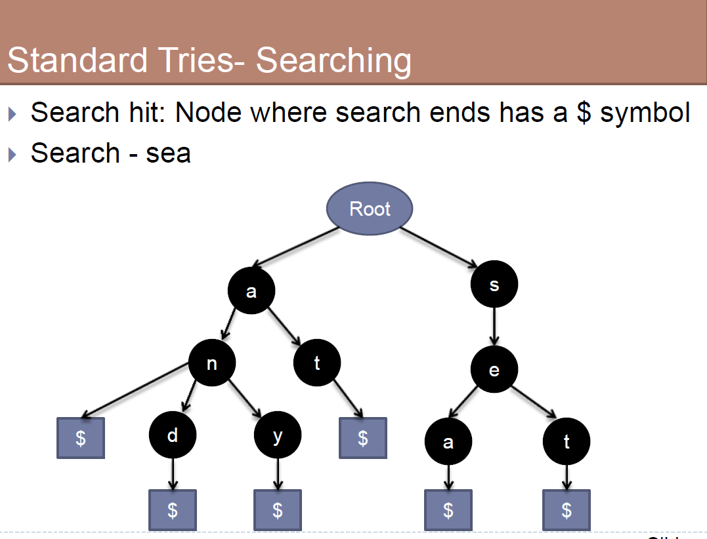

Slide 14
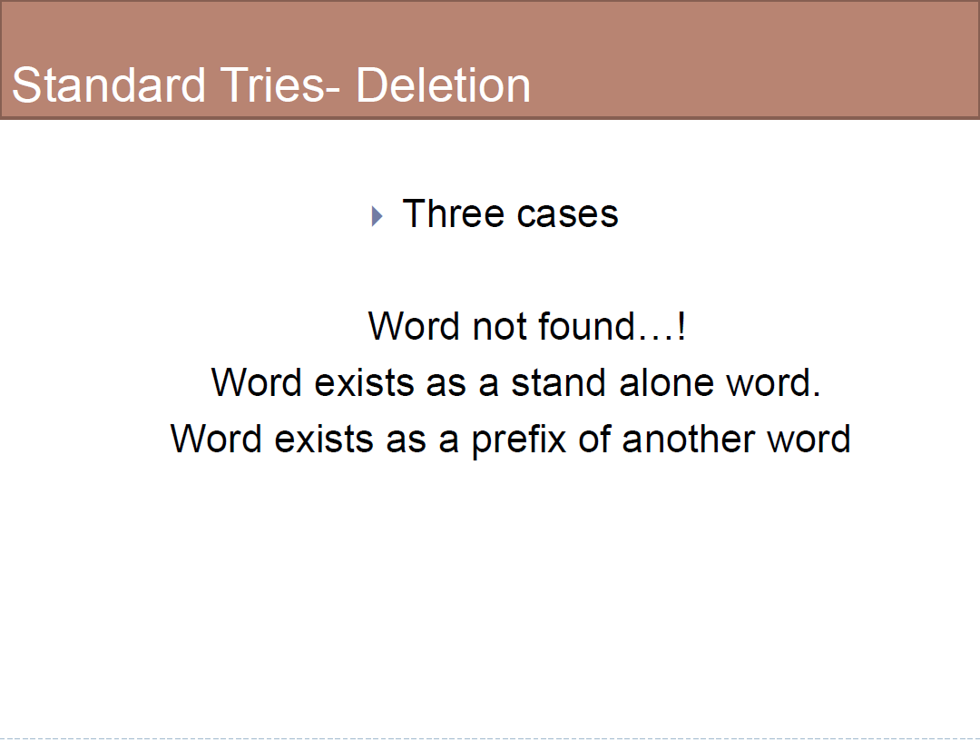

Slide 15
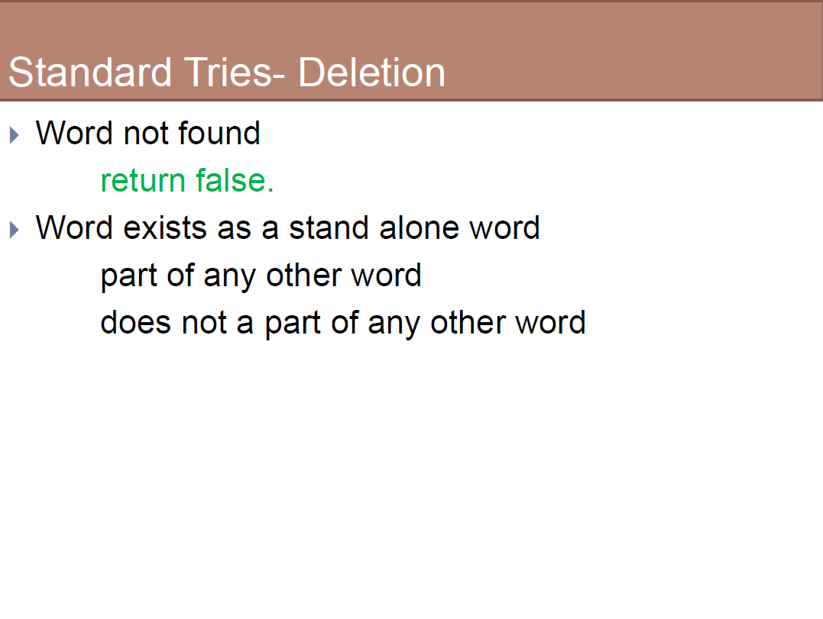

Slide 16
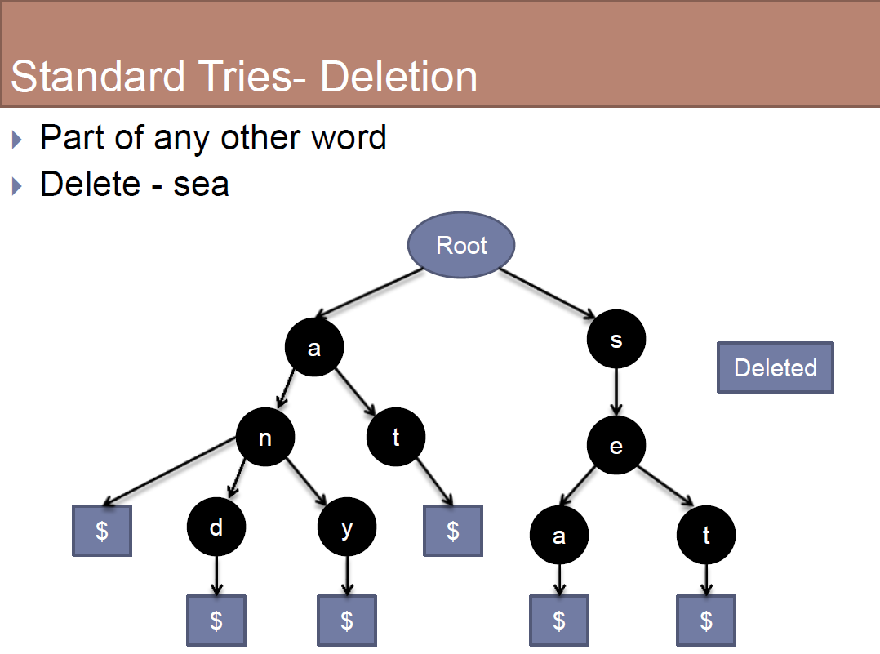

Slide 17
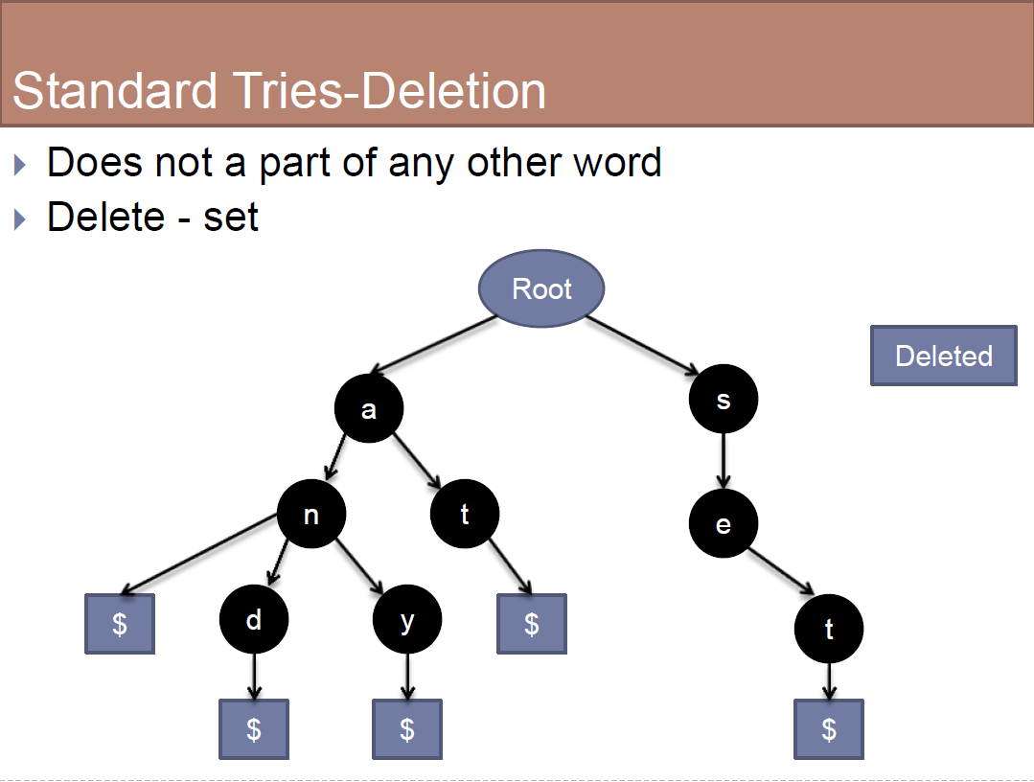

Slide 18
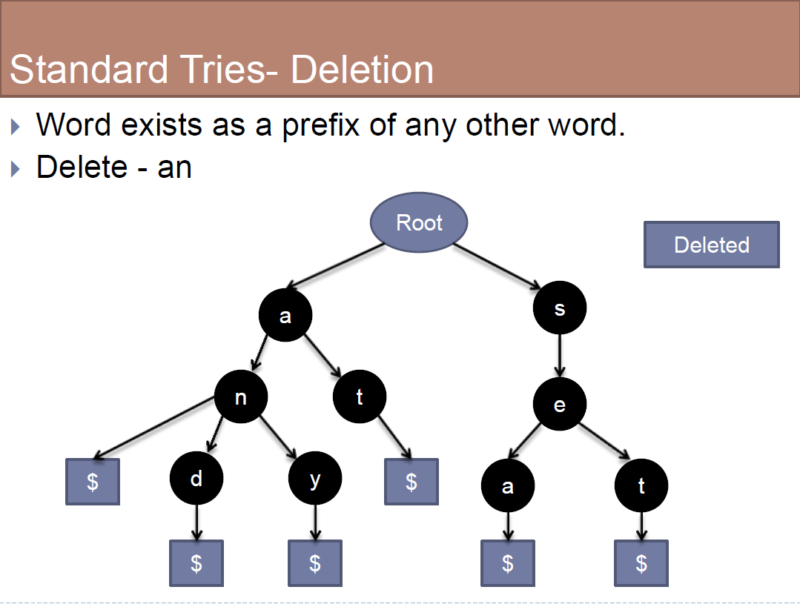

Slide 19
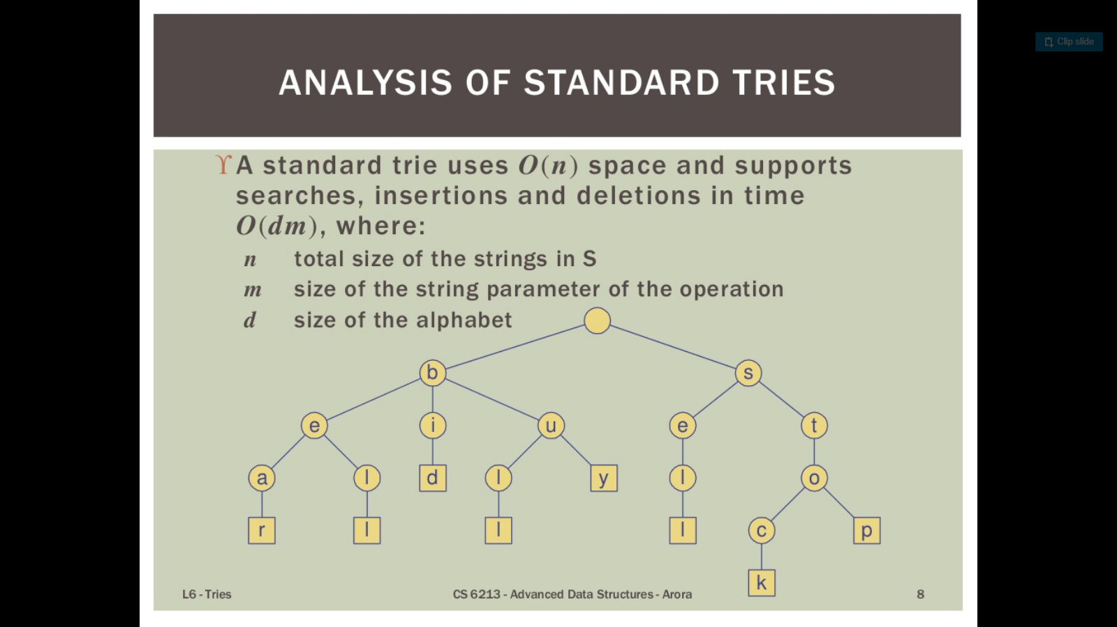
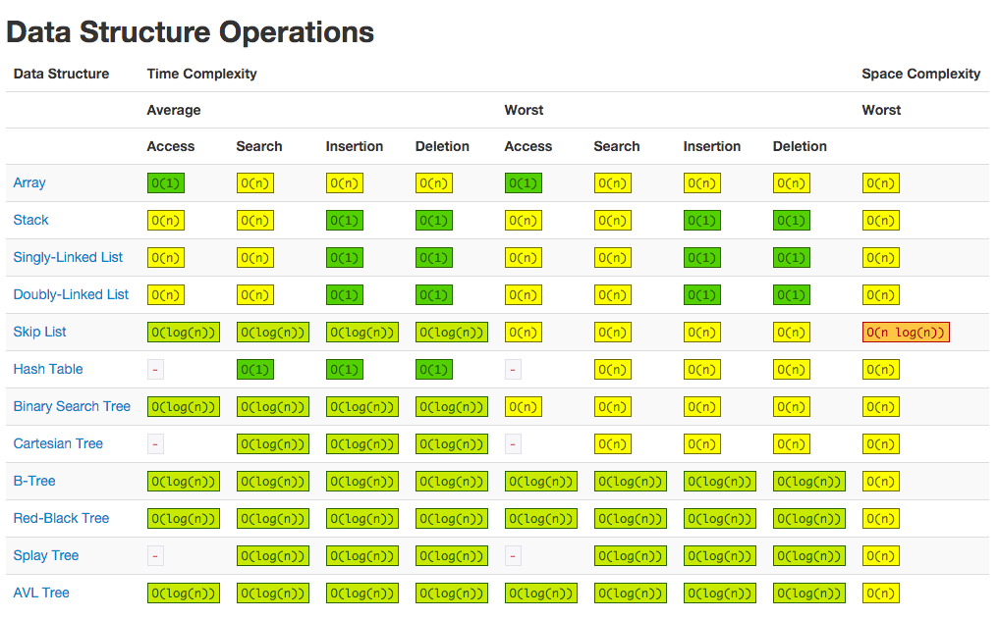
COMAPRISON WITH OTHER DATA STRUCTURES:

Slide 20
OPERATING TIME OBSERVATIONS :
Insertion:
No. of words | Runtime(seconds)
615 | 0.037
3611 | 0.107
4126 | 0.136
252716 | 25.97
255963 | 28.55
Searching :
No. of words | Runtime(seconds)
615 | 1.451e-5
3611 | 2.33e-5
4549 | 2.26e-5
252716 | 4.70e-5
255963 | 7.96e-5
Deletion :
No. of words | Runtime(seconds)
615 | 2.05e-5
3611 | 2.12e-5
4549 | 2.72e-5
252716 | 2.22e-5
255963 | 3.14e-5

Slide 21
Applications :
Auto completion of words.
Auto correction of words.
Sequence Assembly in Genetic Sequence.
Sorting of large set of strings (Burst Sort).
Efficient Implementation of dictionary.

Slide 22
Conclusion:
Insertion is Faster as compared to the Hash Tables.
Lookup is much more faster than the Hash Table Implementations.
There are no collision of different keys in Tries.

Slide 23
THANK YOU ! Any Questions ??

